Slide 1

The Technology Value Stream: Transforming Lead Times in DevOps
Core Principles, Metrics, and the Shift to High Performance
Presenter Name: Aftabur Rahman (Aftab)
CSD380-308A DevOps
Module 1.2 Assignment
06/07/2026

Slide 2

Speaker Notes
Welcome everyone. Today we are exploring Chapter 1 of The DevOps Handbook, specifically focusing on the concept of the Technology Value Stream, how we measure efficiency within it, and why traditional deployment models fail where DevOps succeeds.

Slide 3

Defining the Value Stream
Core Definition: The sequence of activities required to design, produce, and deliver a product or service to a customer (Kim et al., 2021).
The Focus: Emphasizes the flow of work across organizational boundaries.
Manufacturing vs. Tech:
Manufacturing: Linear, physical, highly visible inventory.
Technology: Non-linear, intellectual, largely invisible inventory.

Slide 4

Speaker Notes
Before diving into software, it helps to understand that the concept of a value stream comes from Lean manufacturing. In technology, our value stream begins when a requirement is accepted into the backlog, moves through development and testing, and ends when the feature successfully delivers value to the customer in production.

Slide 5

Measuring the Stream: Lead Time vs. Process Time
Lead Time (LT): The total clock time that elapses from the moment a request is created to the moment it is fulfilled (Kim et al., 2021, p. 9).
Process Time (PT): The actual "hands-on" time a practitioner spends actively working on the task (Kim et al., 2021, p. 9).
The Efficiency Gap: Lead time often dwarfs process time because work spends days or weeks sitting idle in queues between handoffs.

Slide 6

Speaker Notes
On page 9, the textbook emphasizes that if you want to understand value stream efficiency, you must look at the relationship between Lead Time and Process Time. For example, it might only take a developer 2 hours of actual processing time to write a piece of code, but due to internal tickets and waiting periods, it takes 3 weeks of total lead time to reach production.

Slide 7
Visualizing Lead Time and Process Time
[ Ticket Created ] │ ▼ ══════════════════ TOTAL LEAD TIME ══════════════════ │ │ (Wait in Queue) ──► [ DEV WORK ] ──► (Wait for QA) ──► [ QA TESTING ] ──► [ PROD ] ▲ ▲ └─── PROCESS TIME ─────────────────┘
Key Takeaway: Value stream optimization focuses on shrinking the white space (waiting in queues) rather than forcing engineers to work faster during process time.

Slide 8

Speaker Notes
This previous slide diagram illustrates the technology value stream. As you can see, the actual process time—the blue blocks where real engineering happens—is quite small. The bulk of our Lead Time is made up of the white space where work sits in queues waiting for a handoff. To optimize the stream, we must eliminate these waiting periods.

Slide 9

The Common Scenario: Deployment Lead Times Requiring Months
The Upstream/Downstream Split:
Upstream (Design & Dev): Operates in months or quarters using large batch sizes.
Downstream (Testing & Ops): Burdened with heavy, manual deployment processes (Kim et al., 2021, p. 10).
The Handoff Trap: Software is pushed down the stream via ticket queues, leading to massive friction.
Consequences: High context-switching, poor feedback loops, and catastrophic "big-bang" deployment failures.

Slide 10
Speaker Notes
On page 10, the authors describe the painful reality most traditional IT organizations face: deployment lead times requiring months. Because operations and development are completely siloed, software builds up like massive inventory in a warehouse. When it finally comes time to deploy, the sheer size of the changes creates an incredibly risky, stressful event.

Slide 11
The DevOps Ideal: Deployment Lead Times of Minutes
The Target: Developers receive continuous, rapid feedback on their work, enabling code to safely deploy to production in minutes or hours (Kim et al., 2021, p. 10).
How it Achieved:
Shrinking batch sizes (working on small chunks of code).
Automating testing, building, and deployment (CI/CD pipelines).
Integrating QA and Security checks continuously into the development phase.
The Result: High reliability, lower burnout, and immediate value delivered to users.

Slide 12
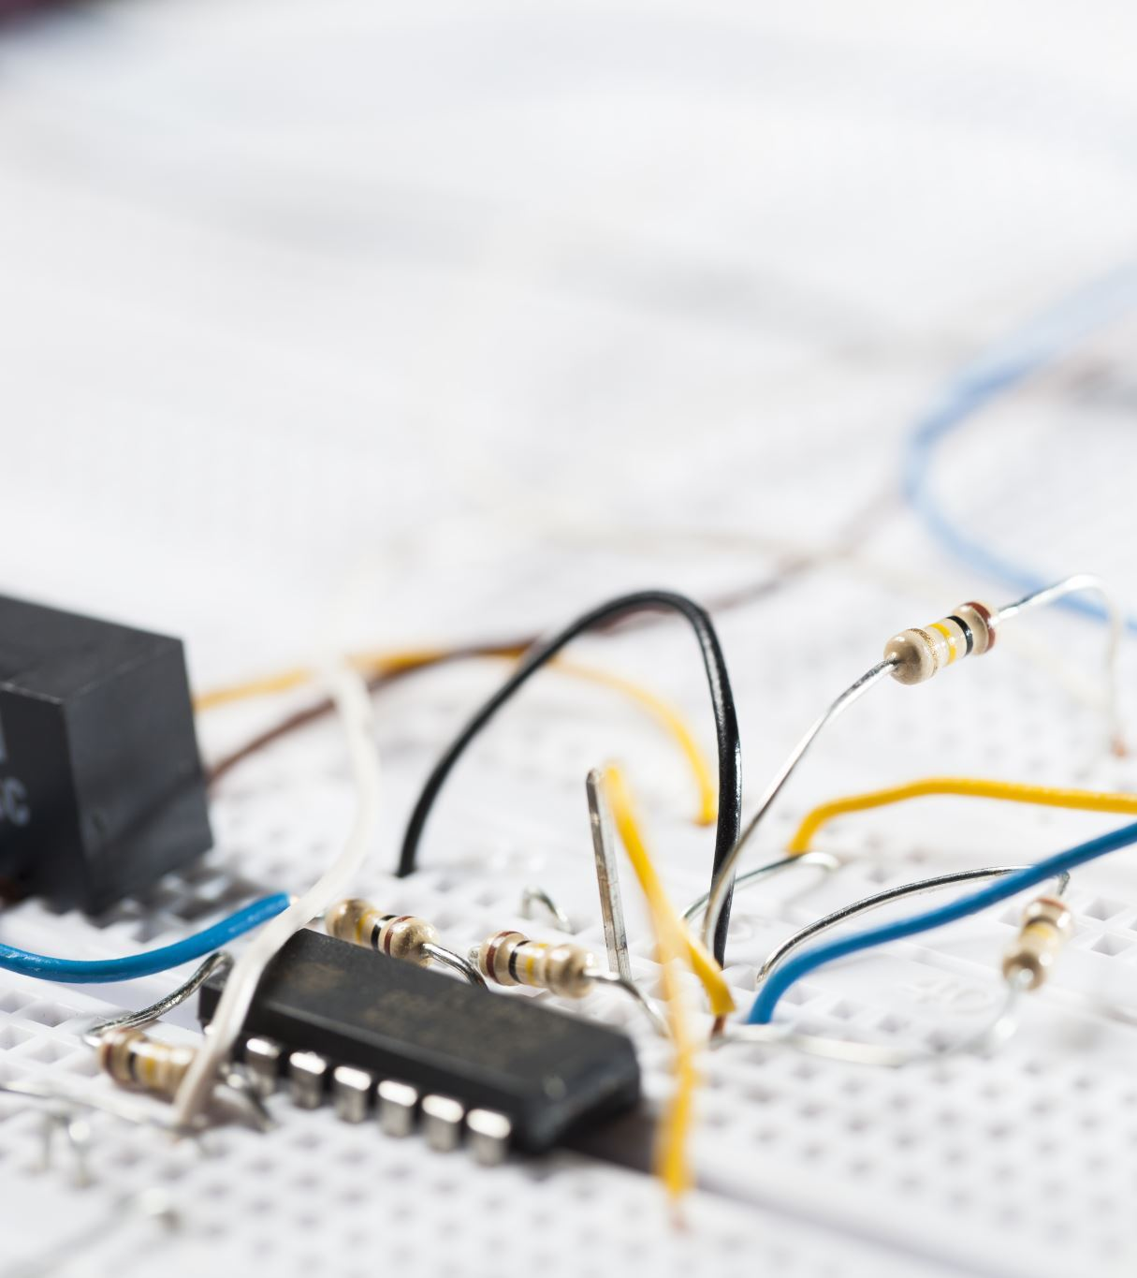
Speaker Notes
The DevOps ideal, also outlined on page 10, completely Flips the script. By checking in small increments of code throughout the day and utilizing automated testing pipelines, we shrink deployment lead times down to minutes. If a bug is introduced, the developer finds out almost immediately, making it incredibly easy to fix.

Slide 13

The Chronic Conflict of Siloed Structures
Siloed Incentives:
Development Goal: Respond to changing business needs by moving fast and shipping features.
Operations Goal: Ensure systemic stability and uptime by resisting rapid changes.
The Resulting Cycle: Dev forces changes through, Ops pushes back with rigid compliance walls, and the value stream grinds to a halt.

Slide 14
Speaker Notes
At the root of the long deployment cycles is a structural flaw. Development is measured on speed, while Operations is measured on stability. DevOps breaks down these silos so both teams share a single, unified goal: the fast, safe delivery of value.

Slide 15

Streamlining the Tech Value Stream
Limit
Limit WIP: Stop flooding the pipeline with too many open projects at once.
Make
Make Work Visible: Use Kanban boards to expose hidden blockages between development, QA, and production.
Automate
Automate Safely: Create environments on-demand so developers don't waste process time waiting for infrastructure.

Slide 16
Speaker Notes
To move from a months-long deployment cycle to a minutes-long cycle, we must apply Lean solutions. This means making our invisible code inventory visible on boards, keeping our Work in Process low, and automating the infrastructure so engineers aren't waiting around for test environments to be built.

Slide 17
Summary of Findings
Efficiency: High-performing technology value streams focus on reducing Lead Time, not just increasing Process Time.
Cultural Shift: Moving from months to minutes requires breaking down the core conflict between Dev and Ops.
Business Impact: Fast deployment lead times directly correlate with market agility, high organizational performance, and team satisfaction.

Slide 18

Speaker Notes
In conclusion, mastering the technology value stream isn't just about downloading automation tools; it's a structural and cultural shift. By focusing on flow, shrinking our batch sizes, and aiming for that minutes-long ideal, we unlock massive competitive advantages.

Slide 19
References
Kim, G., Humble, J., Debois, P., Willis, J., & Forsgren, N. (2021). The DevOps handbook: How to create world-class speed, reliability, and security in technology organizations (2nd ed.). IT Revolution Press.

